Slide 1
Optimization
Neural Networks & Fuzzy Logic (BITS F312)
Ashish Patel
Lectures during November 21 - 28, 2017

Slide 2
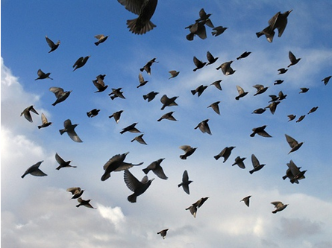
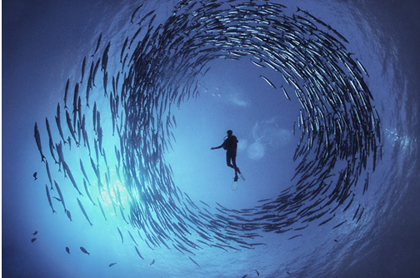
Particle Swarm Optimization
Particle Swarm Optimization(PSO)
Proposed by James Kennedy & Russell Eberhart in 1995
Inspired by social behavior of birds and fishes
Combines self-experience with social experience
Population-based optimization

Slide 3
Concept of PSO
Uses a number of particles that constitute a swarm moving around in the search space looking for the best solution.
Each particle in search space adjusts its “flying” according to its own flying experience as well as the flying experience of other particles.

Slide 4
Swarm: a set of particles (S)
Particle: a potential solution
Position:
Velocity:
Each particle maintains
Individual local best position (LBest)
Swarm maintains its global best (GBest)

Slide 5
PSO Algorithm
Basic algorithm of PSO
Initialize the swarm form the solution space
Evaluate the fitness of each particle
Update local and global bests
Update velocity, inertia, and position of each particle
Check boundary conditions
Go to Step 2, and repeat until termination condition

Slide 6
Original velocity update equation
w_{i} is Inertia factor ∈(0.4,1); c₁ is Cognitive attraction constant ∈(1,3), c₂ is Social attraction constant ∈(1,3)
random₁(), random₂(): random variable
Inertia factor for i^{th} generation (i = 0, 1, …., G-1 where G is total number of generations)
Position update

Slide 7
PSO Algorithm Illustration
Particle’s velocity
x(k+1)
LBest
GBest
:(Social)
v(k+1)
:(Cognitive)
v(k)
x(k)
:(Inertia)

Slide 8
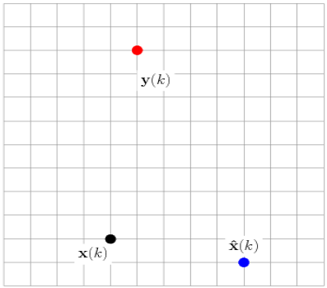

PSO Solution Update in 2D
GBest
LBest
x(k) - Current solution (4, 2)
LBest - Local best solution (9, 1)
GBest-Global best solution (5, 10)

Slide 9
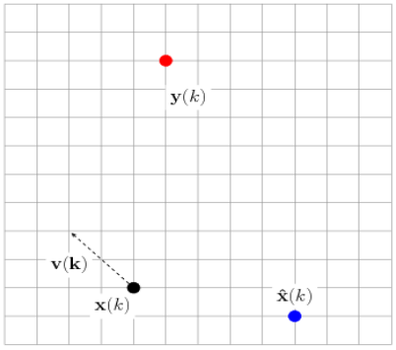
PSO Solution Update in 2D (contd.)
Inertia: v(k)=(-2, 2)
GBest
x(k) - Current solution (4, 2)
LBest - Local best solution (9, 1)
GBest-Global best solution (5, 10)
LBest
Current solution (4, 2)
Particle’s best solution (9, 1)
Global best solution (5, 10)

Slide 10
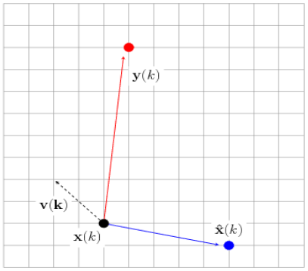
PSO Solution Update in 2D (contd.)
Inertia: v(k)=(-2,2)
Cognitive:
LBest-x(k)=(9,1)-(4,2)=(5,-1)
Social:
GBest-x(k)=(5,10)-(4,2)=(1,8)
GBest
x(k) - Current solution (4, 2)
LBest - Local best solution (9, 1)
GBest-Global best solution (5, 10)
LBest

Slide 11
PSO Solution Update in 2D (contd.)
Inertia: v(k)=(-2,2)
Cognitive:
LBest-x(k)=(9,1)-(4,2)=(5,-1)
Social:
GBest-x(k)=(5,10)-(4,2)=(1,8)
v(k+1) =(-2,2)+0.8*(5,-1) +0.2*(1,8)
= (2.2,2.8)
GBest
v(k+1)
x(k) - Current solution (4, 2)
LBest - Local best solution (9, 1)
GBest-Global best solution (5, 10)
LBest

Slide 12
PSO Solution Update in 2D (contd.)
Inertia: v(k)=(-2,2)
Cognitive:
LBest-x(k)=(9,1)-(4,2)=(5,-1)
Social:
GBest-x(k)=(5,10)-(4,2)=(1,8)
v(k+1)=(2.2,2.8)
x(k+1) =x(k)+v(k+1)
=(4,2)+(2.2,2.8)=(6.2,4.8)
GBest
x(k+1)
x(k) - Current solution (4, 2)
LBest - Local best solution (9, 1)
GBest-Global best solution (5, 10)
LBest

Slide 13
Numerical Example
Minimize:
f(x₁, x₂) = (x₁² + x₂ - 11)²+(x₁ + x₂² - 7)²
0< x₁ , x₂ < 6
c₁ = c₂ = 1.05
w_{max} = 1.0, w_{min} = 0.4
Maximum number of iterations = 30

Slide 14
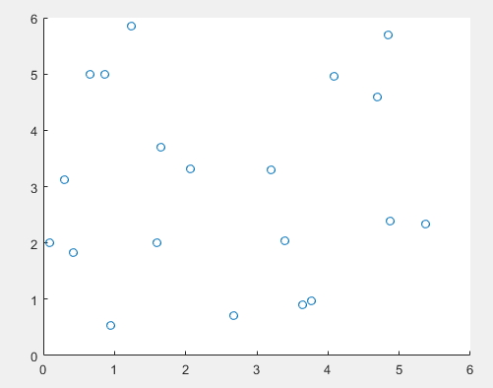
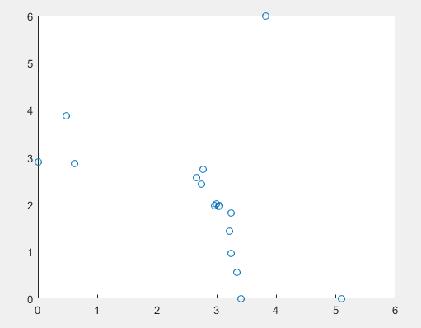
Numerical Example - Solution
After 30 iterations
f(x₁, x₂) = 0.0070
x₁ = 3.0047, x₂ = 1.9778
Initial points
Final points

Slide 15
Thank You. All the best.

